Slide 1
Computer Vision – Module 5
Dr. Sreejith Rajan

Slide 2
Interest Point Detection (Keypoint Detection)
Core Idea: Instead of processing the entire image, we focus only on important, repeatable points.
👉 These are points that:
Are easy to detect again
Do not change much with rotation, scale, lighting
Examples:
Corners of objects
Edges with strong contrast
Blob-like structures

Slide 3
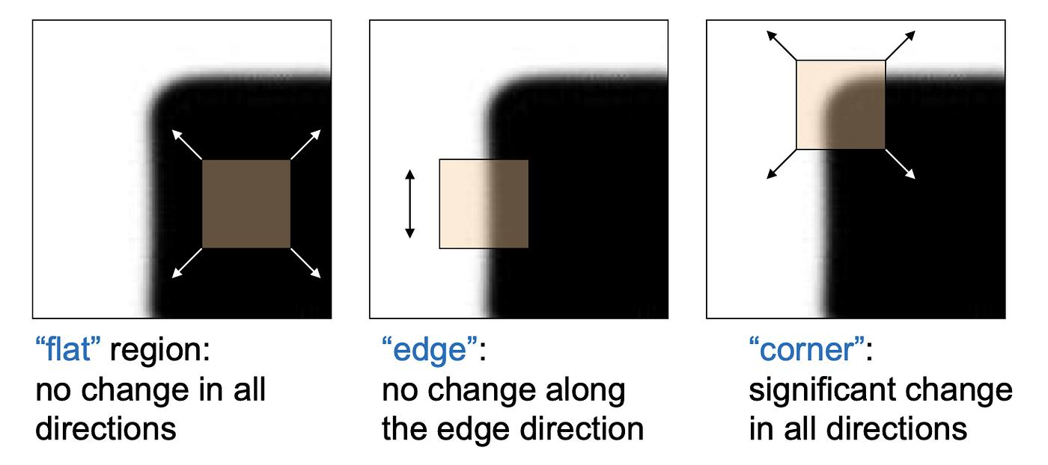
Harris Corner Detector
Based on intensity change in small window, If intensity changes in:
One direction → edge
No direction → flat
All directions → corner

Slide 4

Mathematical Insight
We compute matrix:
$$M=\left[\begin{matrix}I_{x}^{2} & I_{x}I_{y} \\ I_{x}I_{y} & I_{y}^{2}\end{matrix}\right]$$
Then:
$$R=det⁡\left(M\right)−k{\left(\text{trace}\left(M\right)\right)}^{2}$$
Interpretation:
$R>0$→ corner
$R<0$→ edge
$R≈0$→ flat

Slide 5
Key Properties
Rotation invariant
Not scale invariant

Slide 6
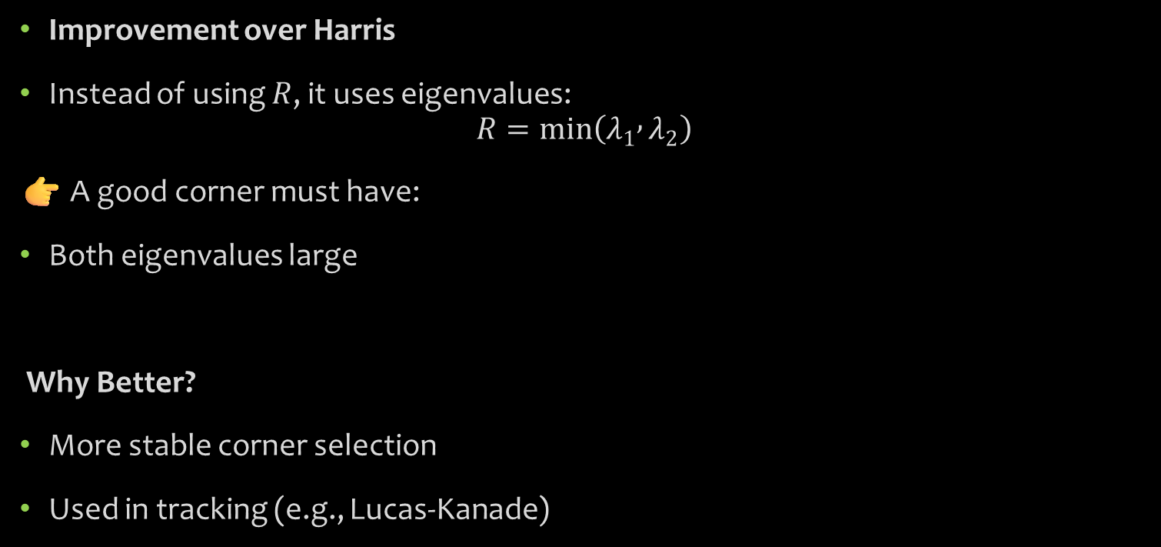
Shi-Tomasi Detector
Improvement over Harris
Instead of using $R$, it uses eigenvalues:
$$R=min⁡\left(λ_{1} , λ_{2}\right)$$
👉 A good corner must have:
Both eigenvalues large
Why Better?
More stable corner selection
Used in tracking (e.g., Lucas-Kanade)

Slide 7
FAST-Features from Accelerated Segment Test
Working
Take a circle of 16 pixels around a point
Compare intensities:
If many are brighter/darker → corner
Key Strength
Extremely fast (no heavy math)
Used in:
Mobile vision
SLAM
Embedded AI

Slide 8
Feature Descriptors
Core Idea
Once keypoints are detected → we must describe them numerically
Why?
Because computers compare numbers, not pixels

Slide 9
SIFT (Scale-Invariant Feature Transform)
1. Scale-space creation
Blur image at multiple scales
2. Difference of Gaussian (DoG)
Detect extrema (potential keypoints)
3. Keypoint localization
Remove weak/unstable points
4. Orientation assignment
Compute dominant gradient direction
5. Descriptor creation
Divide region into 4×4 grid
Compute gradient histograms
👉 Final: 128-dimensional vector

Slide 10
Strength
Invariant to:
Scale
Rotation
Illumination (partially)
Limitation
Heavy computation

Slide 11
SURF (Speeded-Up Robust Features)
SURF is designed to approximate SIFT but much faster, while still being robust to:
Scale changes
Rotation
Illumination (partially)

Slide 12
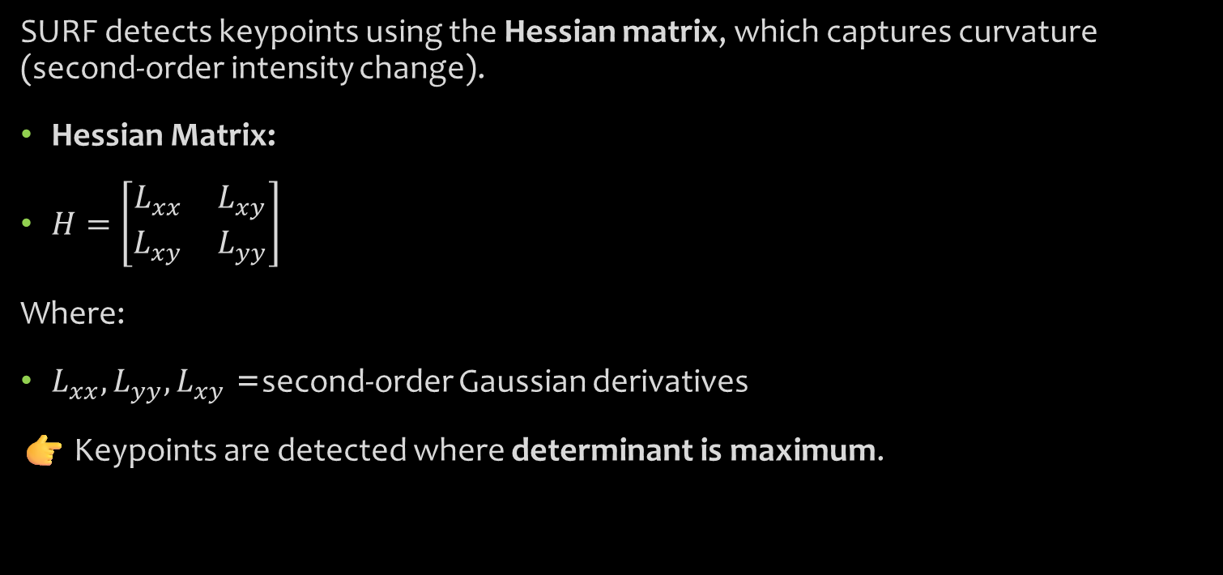
Key Concept: Hessian Matrix
SURF detects keypoints using the Hessian matrix, which captures curvature (second-order intensity change).
Hessian Matrix:
$H=\left[\begin{matrix}L_{xx} & L_{xy} \\ L_{xy} & L_{yy}\end{matrix}\right]$
Where:
$L_{xx},L_{yy},L_{xy}$= second-order Gaussian derivatives
👉 Keypoints are detected where determinant is maximum.

Slide 13
Speed Optimization (Why SURF is Fast)
🔹 Integral Images
Converts image into cumulative sum representation
Allows fast computation of box filters
Computation becomes independent of filter size
🔹 Box Filters instead of Gaussian
Approximates Gaussian with rectangular filters
Much faster computation

Slide 14
Advantages of SURF
Faster than SIFT
Scale + rotation invariant
Good robustness
Limitations
Still computationally heavy for embedded systems
Patent restrictions (historically limited usage)

Slide 15
ORB (Oriented FAST and Rotated BRIEF)
ORB is designed for: Real-time, low-power systems
It combines:
FAST → keypoint detection
BRIEF → descriptor

Slide 16
1. Keypoint Detection (FAST)
Uses intensity comparison around a circle
Very fast binary decision
Not rotation invariant ❌
2. Orientation Assignment (Fixing FAST)
ORB adds: Intensity centroid method
👉 Computes direction of patch:
Gives orientation angle
Now rotation invariant

Slide 17

3. Descriptor: BRIEF (Binary Robust Independent Elementary Features)
Idea: Compare intensity of pixel pairs
Example:
$τ\left(p_{i} , p_{j}\right)=\left\{\begin{matrix}1 & \text{if} I\left(p_{i}\right)<I\left(p_{j}\right) \\ 0 & \text{otherwise}\end{matrix}\right.$
Generates binary string

Slide 18
4. Rotated BRIEF (rBRIEF)
Rotates descriptor according to keypoint orientation
Ensures rotation invariance
5. Matching
Uses Hamming distance (very fast)

Slide 19
SURF VS ORB
Feature | SURF | ORB
Speed | Medium | Very Fast
Descriptor | Float (64D) | Binary
Matching | Euclidean | Hamming
Accuracy | High | Moderate
Scale Invariance | Yes | Limited
Rotation Invariance | Yes | Yes
Use Case | High accuracy | Real-time systems

Slide 20
Feature Matching
The idea is to match features between two images
👉 Example:
Same object in two images
Find corresponding points

Slide 21
Brute Force Matching
Try everything and pick the best match
For every feature in Image A:
Compare with all features in Image B
Choose the closest one
Think of it like: “Compare one fingerprint with every fingerprint in the database and pick the closest match.”

Slide 22

Working Steps
Extract descriptors from two images
Image A → $D_{A}=\left\{d_{1} , d_{2} , . , ..d_{n}\right\}$
Image B → $D_{B}=\left\{d_{1}^{′} , d_{2}^{′} , . , ..d_{m}^{′}\right\}$
For each descriptor $d_{i}$in A:
Compute distance with all descriptors in B
Select:
Best match (minimum distance)

Slide 23
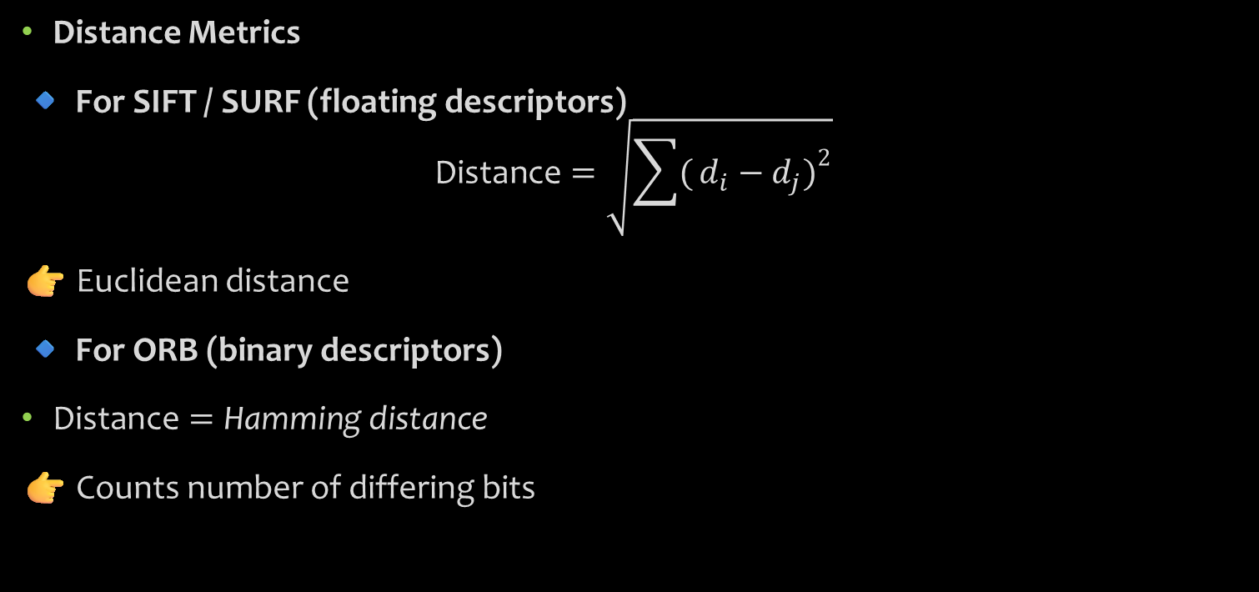
Distance Metrics
🔹 For SIFT / SURF (floating descriptors)
$$\text{Distance}=\sqrt{\sum{(}\left.d_{i}−d_{j}{\left.)\right.}^{2}\right.}$$
👉 Euclidean distance
🔹 For ORB (binary descriptors)
$\text{Distance}=\text{Hamming} \text{distance}$
👉 Counts number of differing bits

Slide 24
FLANN Matcher (Fast Library for Approximate Nearest Neighbors)
Don’t search everything - search smartly
Instead of checking all points:
Use data structures (trees/clusters)
Find approximate nearest neighbor
Intuition : “Instead of searching the whole city, go directly to the right neighborhood.”

Slide 25
Working Principle
FLANN builds an index structure:
Common Methods:
KD-Tree (for low dimensions)
K-means tree (for high dimensions)
Step-by-Step
Build index on descriptors (Image B)
For each descriptor in A:
Search nearest neighbors using tree
Return approximate best matches

Slide 26
BF vs FLANN
Feature | Brute Force | FLANN
Method | Exhaustive search | Approximate search
Speed | Slow | Fast
Accuracy | High | Slightly lower
Complexity | (O(nm)) | (O(n \log m))
Best For | Small datasets | Large datasets

Slide 27

Homography and Image alignment
Core Idea
Find transformation between two images
👉 Maps: One plane → another plane
Equation
$$\left[\begin{matrix}x^{′} \\ y^{′} \\ 1\end{matrix}\right]=H\left[\begin{matrix}x \\ y \\ 1\end{matrix}\right]$$
Where:
$H$= 3×3 matrix
Needs at least 4 matching points

Slide 28
What It Handles
Rotation
Translation
Scaling
Perspective distortion
Applications
Object detection
Augmented reality
Image stitching

Slide 29
RANSAC (Random Sample Consensus)
Core Problem
When you match features between two images:
We get:
Correct matches (inliers)
Wrong matches (outliers)
These wrong matches come from:
Noise
Repetitive textures
Descriptor errors

Slide 30
Goal of RANSAC
👉 Find a correct mathematical model (like a line, homography, etc.) 👉 Ignore outliers automatically
Think like this:
“If most matches are correct, I can randomly pick a few points, build a model, and check how many agree with it.”
The correct model will have maximum agreement (inliers)

Slide 31
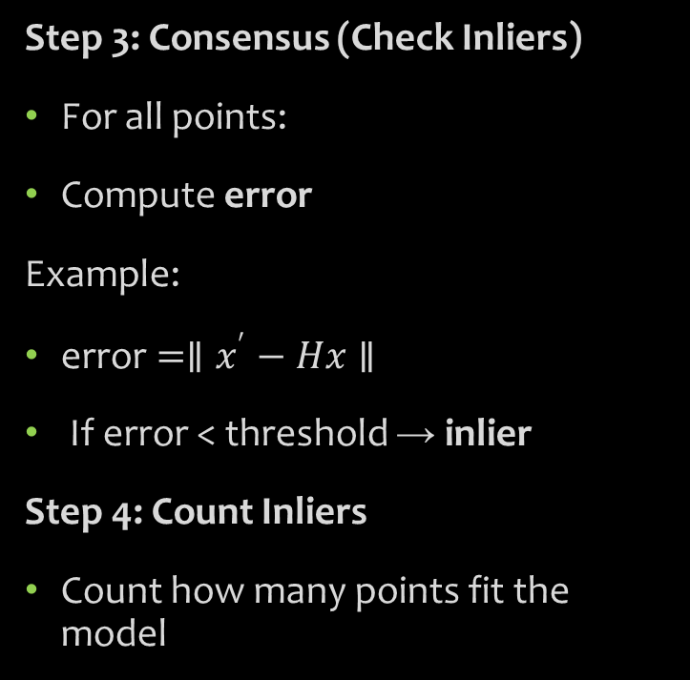
Algorithm
Step 1: Random Sampling
Select minimum number of points
Line → 2 points
Homography → 4 points
Step 2: Model Estimation
Compute model using selected points
Example:
Line equation
Homography matrix
Step 3: Consensus (Check Inliers)
For all points:
Compute error
Example:
$\text{error}=∥x^{′}−Hx∥$
If error < threshold → inlier
Step 4: Count Inliers
Count how many points fit the model

Slide 32
Step 5: Repeat
Repeat steps many times
Step 6: Select Best Model
Choose model with:
Maximum inliers
Minimum error
Step 7: Final Refinement
Recompute model using all inliers

Slide 33
RANSAC in image processing
With Feature Matching
After matching:
Many incorrect matches
RANSAC:
Removes wrong matches
Keeps only consistent ones
With Homography
To compute homography:
Minimum points needed = 4
RANSAC:
Selects 4 matches
Computes transformation
Checks consistency
Complete Pipeline Integration
Where RANSAC fits:
Keypoints → Descriptors → Matching → RANSAC → Homography → Application

Slide 34
Application –Panorama Creation
It is a perfect demonstration application where all steps of the pipeline are used together.
Step-by-step pipeline
1. Feature Detection
Detect keypoints using:
Harris / FAST / ORB
👉 Finds distinctive points in images

Slide 35
2. Feature Description
Describe each keypoint using:
SIFT / SURF / ORB
👉 Converts keypoints into numerical vectors
3. Feature Matching
Match descriptors using:
Brute Force / FLANN
👉 Finds corresponding points between images

Slide 36
4. RANSAC (Critical Step)
Removes wrong matches
Keeps only correct correspondences
5. Homography Estimation
Compute transformation between images
👉 Aligns images geometrically
6. Image Warping & Stitching
Transform images
Blend them together

Slide 37
Why Panorama is importanr
It uses EVERY concept in this module:
Concept | Role in Panorama
Feature Detection | Find keypoints
Descriptor | Represent features
Matching | Find correspondences
RANSAC | Remove wrong matches
Homography | Align images
Final Output | Stitched panorama
Panorama creation is like a complete system integration problem

